Slide 1

Building a High-Accuracy
Survival Prediction System
Using Machine Learning
From Raw Data to Reliable Predictions
Khushi Choudhary
Roll No: 23f3002872
BS Data Science – IIT Madras

Slide 2
01 / Motivation
Why This Topic Matters
01
02
03
Real-world Complexity
End-to-End Pipeline
Industry Simulation
ML problems are messy and complex, requiring rigorous methodology and systematic problem-solving approaches.
Demands preprocessing, feature engineering & evaluation discipline throughout the entire workflow.
Simulates industry-style data science workflow with production-grade considerations.
Core Objective
Predict whether a passenger survived based on historical voyage data, using features like age, gender, ticket class, fare, and related characteristics.

Slide 3
02 / Problem Definition
Problem Setup
Prediction Task
Available Features
Binary Classification
Demographics
Socio-Economic
Family Structure
1
Survived
Gender
Ticket Tier (Class)
RelativesAboard
0
Deceased
Age
Fare & TicketCost
ParentsChildren
Title (extracted)
PassengerID & Name
Berth Location
FamilySize, Singleton
Based on passenger characteristics and voyage details
Total Feature Dimensions
14+
Key Challenges
Missing data in critical fields
High cardinality in categorical features
Risk of overfitting on limited samples
Potential for data leakage

Slide 4
03 / Data Preparation
Data Preprocessing & Cleaning
Missing Value
Feature
Categorical
Noise
Imputation
Scaling
Encoding
Removal
Improves training stability through consistent data distributions
Reduces algorithmic bias by normalizing feature scales
Directly enhances prediction accuracy through quality control
15–20%
Impact
Preprocessing directly enhances prediction accuracy
accuracy improvement

Slide 5
04 / Feature Engineering
The Secret Weapon
RichWoman
PoorMan
Interaction Feature
Interaction Feature
Combines female gender with upper-class status, capturing the "women and children first" protocol that was biased towards wealth.
Male passengers in lower ticket tiers faced significantly reduced survival rates due to cabin location and social protocols.
High survival correlation
Low survival correlation
Family Survival Rate
Methodology
Out-of-Fold
Leakage-free encoding of family group survival patterns using out-of-fold methodology to prevent target information bleeding.
Impact
Key Insight
+6–7%
Domain knowledge and creative feature design often outperform model complexity
accuracy improvement

Slide 6
05 / Data Integrity
Data Leakage & Prevention Strategy
What is Data Leakage?
Solution Applied
Unintentional use of target information during training, creating artificially inflated performance that fails in production.
Out-of-Fold Encoding
Calculated family survival rates using only data from other cross-validation folds, preventing information leakage.
Detected Issue
Family-based survival encoding was using future information, causing:
1
Split data into k folds
2
Encode using only other folds
Training Accuracy
Generalization
Prevent target bleeding
96%
3
Poor
Result Achieved
Artificially high performance that doesn't translate to real-world scenarios
Honest, generalisable performance metrics that accurately predict real-world model behaviour

Slide 7
06 / Model Selection
Model Selection & Training
Model | Type | Accuracy
Logistic Regression | Baseline | 79.00%
Random Forest | Ensemble | 82.90%
K-Nearest Neighbours | Distance-based | 81.00%
XGBoost | Gradient boosting | 84.15%
CatBoost WINNER | Gradient boosting | 86.58%
Why CatBoost Emerged Victorious
Native Categorical Handling
Processes categorical features without manual encoding, reducing preprocessing complexity
Tabular Excellence
Specifically optimised for structured data problems, outperforming alternatives
Overfitting Resistance
Built-in regularisation and ordered boosting prevent memorisation of training noise
Performance Gap
+2.43%
vs. second best (XGBoost)

Slide 8
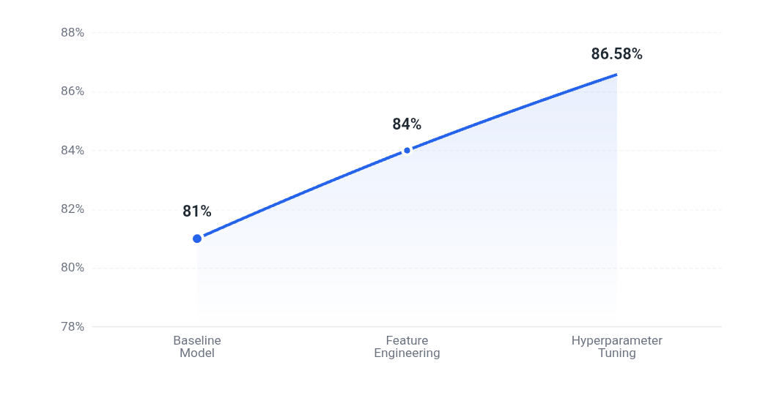
07 / Optimization
Optimization Journey & Accuracy Evolution
Baseline
Accuracy Evolution
Initial Model
CatBoost with minimal preprocessing, default parameters
81%
accuracy
Feature Engineering
Interaction Features
Added RichWoman, PoorMan, Family Survival Rate encoding
84%
accuracy
+3%
Hyperparameter Tuning
Grid Search Optimization
Cross-validation refinement, learning rate and depth optimization
86.58%
accuracy
+2.58%

Slide 9
08 / Outcomes
Results, Insights & Challenges Overcome
Final Accuracy
Challenges Faced
86.58%
Leakage Detection
Required careful audit of all engineered features to identify and eliminate sources of target information bleeding
Achieved through systematic methodology and rigorous validation
High-Cardinality Encoding
Balancing information retention with overfitting risk when encoding categorical variables with many unique values
Key Learnings
Engineering Over Complexity
Missing Data Strategy
Domain knowledge and feature design outperform model complexity
Choosing between imputation methods (mean, median, mode, predictive) for optimal performance on each feature
Leakage Prevention Critical
Out-of-fold encoding ensures honest performance metrics
Clean Pipelines Win
Academic honesty: Each challenge was addressed through systematic experimentation and validation, not trial-and-error.
Systematic preprocessing and validation drive results

Slide 10

09 / Conclusion
Conclusion & Future Scope
Conclusion
Future Scope
Built a production-grade ML pipeline with strong generalization capabilities
Ensemble learning techniques
Deep learning models (neural networks)
Demonstrated that methodology trumps complexity in machine learning
API deployment using Flask
"This project demonstrates that success in machine learning stems not from model complexity, but from rigorous methodology, domain understanding, and careful attention to data quality."
---- Thank You

